Slide 1
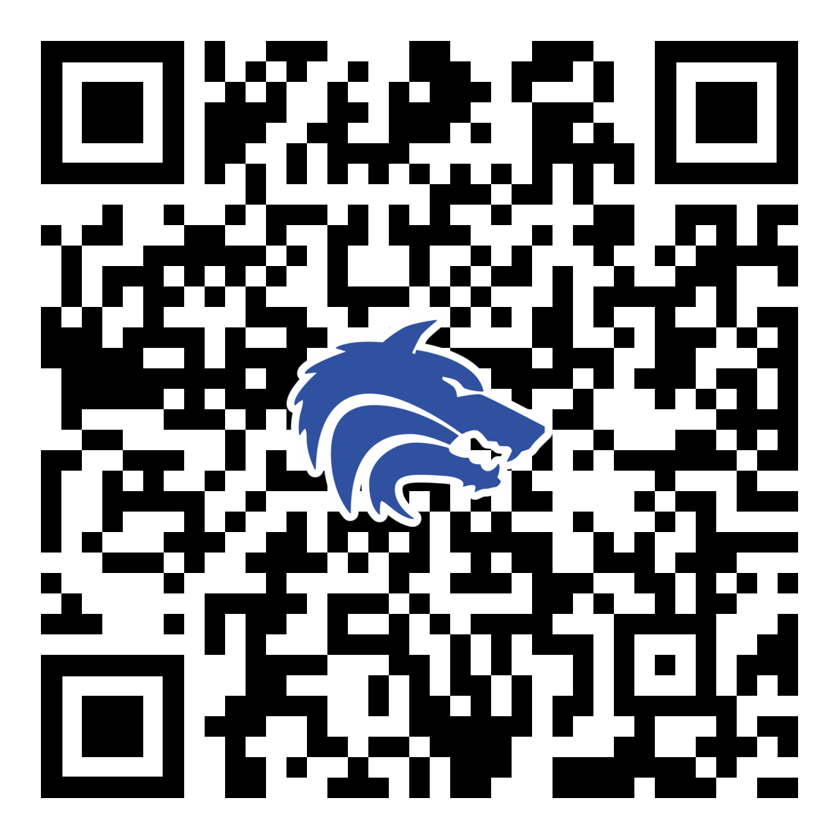
2025-2026 Booster Club Meeting
November 10, 2025
PLEASE SCAN THIS CODE TO CHECK IN

Slide 2
Agenda
Approve September Meeting Minutes
Treasurer Report
Discuss OPEN President Position
Fall Fundraising Poinsettia
Coach’s Corner-Update on field status
Join the Baseball Booster Club

Slide 3
Booster Club Votes
Approve September 2025 Meeting Minutes
Meeting Minutes can always be found on the website (https://www.planowestbaseball.org/) under BOOSTER CLUB\FORMS AND MEETING MINUTES
Each meeting we will ask for someone to make a motion to approve the minutes and then we will ask for someone to second that.

Slide 4
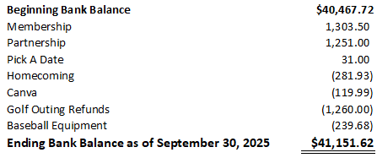
Treasurer’s Report: September 2025

Slide 5
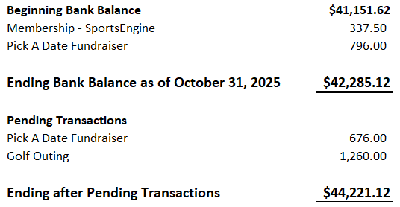
Treasurer’s Report: October 2025

Slide 6
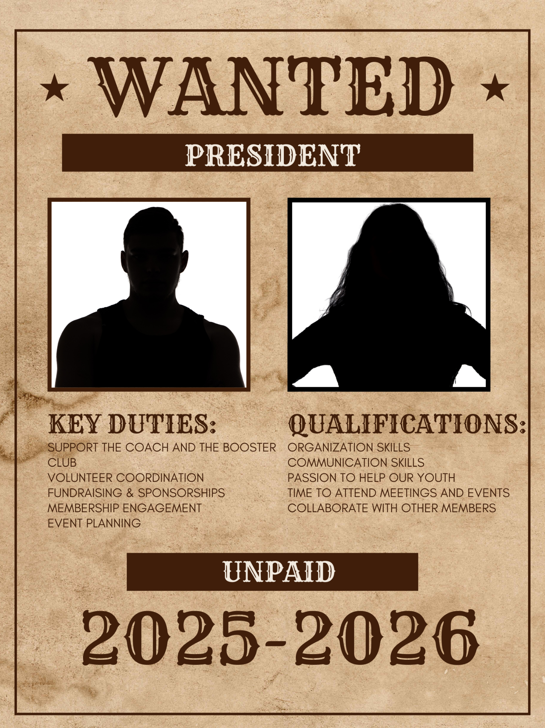
OPEN Position President of the Booster Club

Slide 7
Upcoming Fundraisers
Fundraising
Poinsettia Fundraiser Sales – More to come on this soon! Be ready to buy some poinsettias
Poker Tournament- Upcoming

Slide 8

Upcoming Dates:
Spring Semester/Baseball Tryouts Start - January 6, 2026
Spring Baseball Season Starts - January 16, 2026
Media Day - January 24, 2026
First Pitch Dinner - February 18, 2026

Slide 9
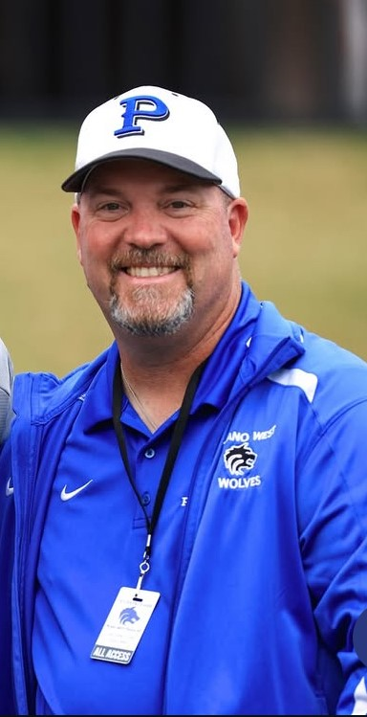
Coach’s Corner

Slide 10
Committees Assembling
Spring Baseball is fast approaching. Please make sure to continue checking SportsYou for a SignUp Genius of volunteer opportunities.

Slide 11
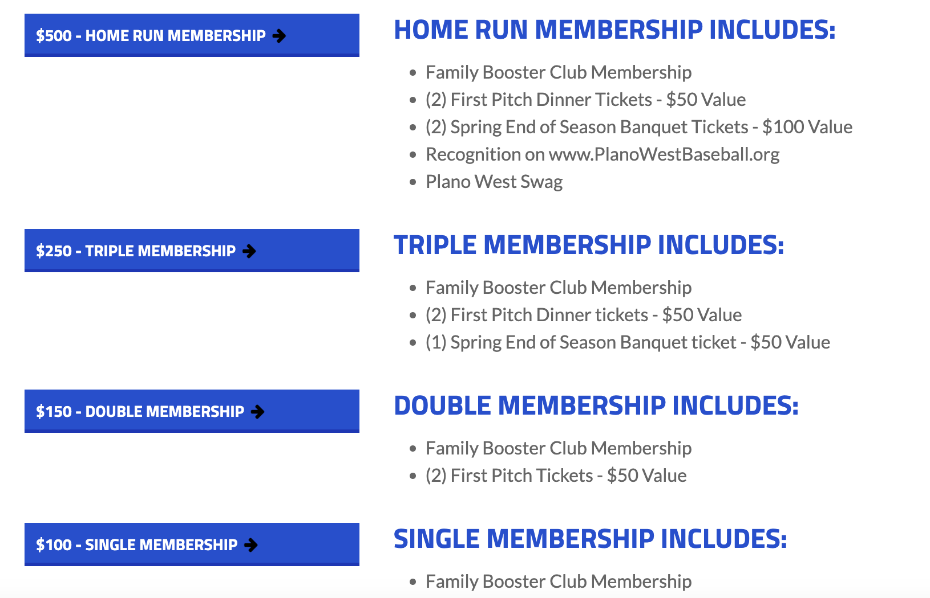
Join The Booster Club
www.planowestbaseball.org/join

Slide 12
Checklist
Join the Booster Club
Fundraising Ideas
who do you know - business owners, tax deductions, Plano based firms
what is working with other organizations?
Join a Committee
we welcome all to participate/contribute in any way they can
Thanks for coming!

Slide 13

SportsYou
DCMN-ZE9D

Slide 14
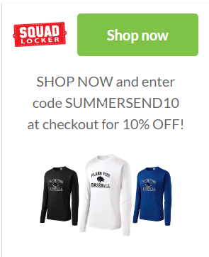
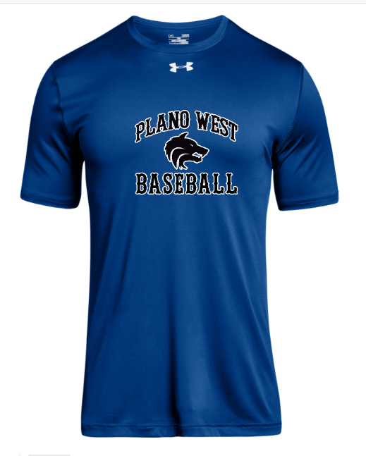
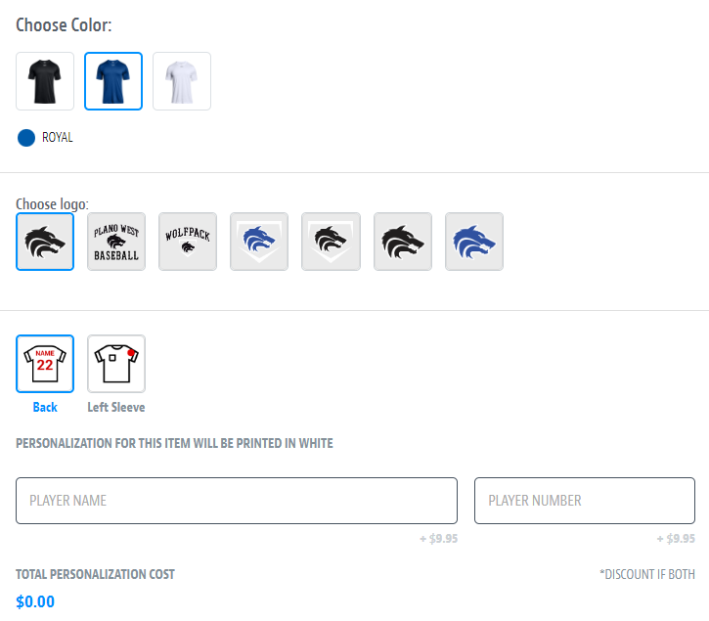
Spirit Wear – powered by SQUADLOCKER
aaaaa
SHOP NOW and enter code SUMMERSAVING10 at checkout for 10% OFF!

Slide 15
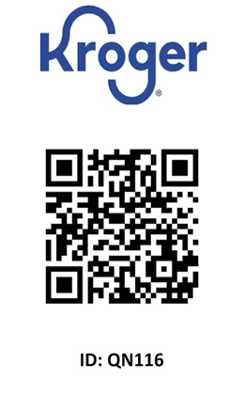
Kroger Rewards Card
Please be sure to link your Kroger card to Plano West Baseball.
$36.92 in donations from May 24 to August 24, 2025.
19 households participated during this time period.

Slide 16
Don’t Forget to Check In!

Slide 17
Thank you!

