Slide 1


Schaumburg Athletic Association - Baseball
Hitting progression
May be done off of tee, underhand, or live
Tony Tichy

Slide 2
Quiet head, hands, and feet
Hitting Mission Statement

Slide 3
Hitting drills
Stork
No feet
45 degree open
Back foot only
Back Foot Only - 45 Degree Variation

Slide 4
Stork
A stolen golf drill!
Focus on balance
Staying quiet
Good path

Slide 5
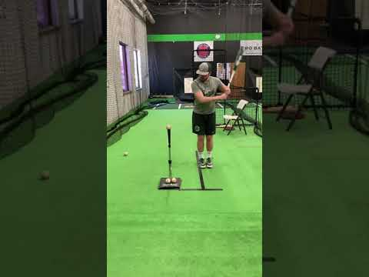
Stork drill
Notes:
Keep your knees bent, and maintain that bend. This drill allows hitters to work on top half of their swing allowing them to remove the lower half movement.

Slide 6
No feet
Same focus as stork drill
Sink into your legs
Jim Thome’s favorite

Slide 7

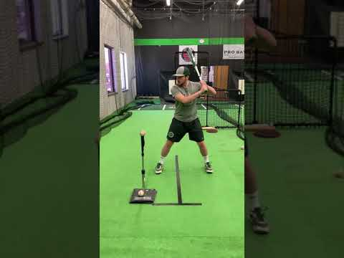
No feet
Notes:
The focus by removing feet is to quiet things done. We teach the hitter that one of the keys to hitting the ball hard is to stay closed as long as you can. After working on the stork drill this drill feels great!

Slide 8
45 degree open
Focus on hand path
Connecting elbow to side
Drive ball up the middle

Slide 9
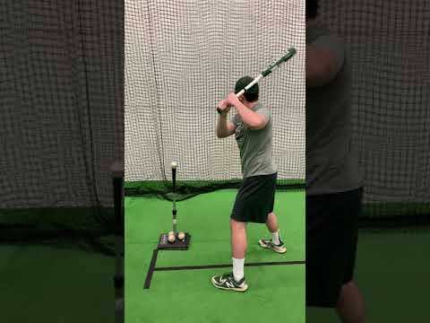
45 degree open
Notes:
The focus is to stay inside the baseball. Despite being open with your hips hit the ball straight. Great drill to emphasize inside out approach.

Slide 10
Back foot only
Swing starts from the back side
Drive your back knee
Maintain balance throughout swing
Finish and hold

Slide 11
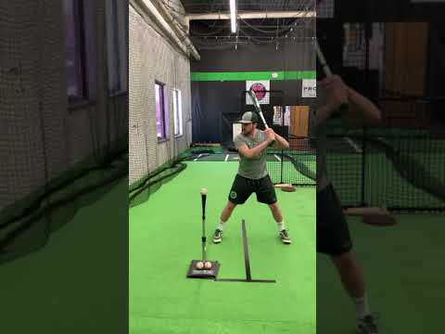
Back foot only
Notes:
Slowly brings back some movement into the swing. Most young hitters let the front foot fly open in their swings. In this drill work against the front foot by activating the back foot.

Slide 12
Back Foot Only - 45 Degree Variation
Josh Donaldson’s favorite
Front foot set in 45 degrees
Feel your hips clear and move fast

Slide 13
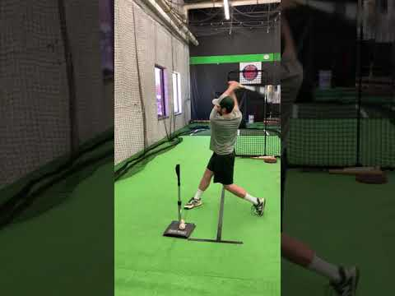
Donaldson
Notes:
Take your front foot and place it into the 45 degree angle position. This is the angle you try to maintain as you finish swinging.

