Slide 1

STMA Youth Baseball Traveling Teams 2025
Parent, Coaches, and Players Meeting
February 12, 2025
The core purpose of STMA Youth Baseball
is to teach our players to play organized baseball
in an atmosphere of fair play, good sportsmanship,
teamwork and fun
Note: This presentation is posted on the traveling team page of our website

Slide 2

Agenda
STMA Youth Baseball Board
STMA Youth Baseball Coordinators
STMA Travel Coaches
STMA and MYAS Code of Conduct
STMA Youth Baseball Commitment
Supporting Our Athletes in Performance and Development
Travel Baseball Expenses
Tournaments
Uniforms
Practices
Volunteer Check / Volunteer Time
Annual Fundraiser
Field Etiquette
Important Dates
Communications
Expectations for Youth Baseball while in High School

Slide 3
2025 STMA Youth Baseball Board
Chris Geryol: President
Ron Wetzel: Vice President/Travel Director
Hannah Krehbiel Treasurer
Tom Rech: Uniform Director
Levi Fry: Player Development Director/Legion
Tim Rick: Tournament Director
Mike Allbee: Fundraising and Sponsorship Director
Davis Keller: Field and Facilities Director
Nathan Mashek: Equipment Director
Allison Schultz: Secretary and Technology Director
Jason Kennedy: House League Director – Ages 8 and under
Kyle Christen: House League Director – Ages 9 - 14
John Marstein: House League Director – Fall and 15+
** Contact Information can be found on our website under the page “Contact Us” **

Slide 4
2025 STMA Youth Baseball Coordinators
Tom Middaugh: Association Umpire Coordinator
Aaron Schmitz: Compliance Coordinator
Cindy Bowser: Volunteer Coordinator
Kyle Abendroth Equipment Coordinator
Rachel Hoppenrath: Concessions Coordinator
Juanita Marstein: Picture Day Coordinator
House League Coordinators – See “Contact Us” section
** Contact Information can be found on our website under the page “Contact Us” **

Slide 5

2025 Traveling Team Head Coaches
9AAA: Jason Kennedy
9AA Gold: Ryan Zyvoloski
9AA Blue: Ralph Foreman
10A: Tony Dorn
10AA: Jacob Oberle
10AAA: Jeff Mueller
11A: Steve Burke
11AA: Cody Bohm
11AAA: Eric Kolles
12A: Jason Lindula
12AA Blue: Mike Bast
12AA Gold: Josh Weber
12AAA: Greg Rios
13A: Corey Hanson
13AA: Andy Childs
13AAA: Brian Warzecha
14/15A: Peter Schneider
14AA Blue: Travis Hunter
14AA Gold: Aaron Schmitz
14AAA: Rob Geiman

Slide 6
Code of Conduct
STMA & MYAS Code of Conduct Documents
Demonstrate respectful behavior to all coaches, players, parents and umpires.
Alcohol or tobacco use during the game will lead to removal & suspension
If a Player or a Parent is ejected, then the Coach is also ejected
Parent Code of Conduct was acknowledged during registration
Players follow MYAS Code of Conduct, will be signed online
Your behavior is a reflection of our entire STMA community
BE A GREAT TEAMMATE
BE A GREAT FAN

Slide 7
Commitment
Commitment Expectation
Attend all games and practices
Other Athletic events should be secondary; this is Baseball season
Exceptions include, but are not limited to
Family emergencies
Academic events/Homework
School Baseball
Communicate with your coach
Attendance may affect your playing time
Travel Handbook

Slide 8

Supporting Our Athlete in Performance and Development
Video Link

Slide 9

Supporting Our Athlete: Tips
Tip #1: Cheer for the Effort, Not the Score
Tip #2: Let the Coach Be the Coach
Tip #3: Keep Your Cool in the Stands
Tip #4: Be Present Without the Pressure
Tip #5: Keep the Conversation Light

Slide 10
Traveling Baseball Expenses
Travel baseball specific fees per player to cover:
4 Tournaments covered by STMA Youth Baseball
Travel Uniforms
Dome and Indoor Practices (3+ player discount! Message us)
Fundraiser cards
Background check – all coaches
Invoice is done online thru Sports Engine
You will receive an invoice from sports engine in March
Payment is required prior to receiving the traveling uniform
Other possible fees not covered in the traveling fee:
Gate fee’s - Gopher State tournaments always come with a gate fee
State Tournament fees
Replacement pants or uniforms (lost or damaged during the season)

Slide 11
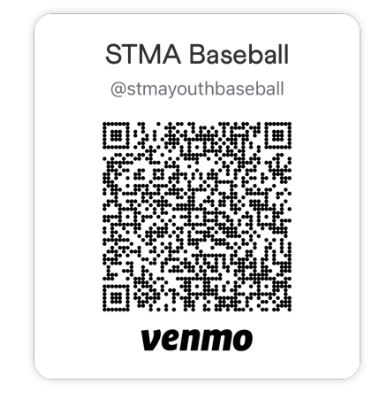
Traveling Baseball Expenses
Payment Options
SportsEngine with transaction fee
Venmo
**Back for Year 2**

Slide 12
Tournaments
4 Tournaments are booked for all traveling teams.
The schedule is on the STMA Youth Baseball website.
Blocks of Hotel rooms are reserved for all out of town tournaments.
Head coaches have all tournament details including hotel information.
Most traveling teams have a chance to qualify for the 3 State Tournaments (MYAS, MBT, and MSF). Those tournaments are in July.
Contact Tournament Director, Tim Rick, with questions

Slide 13
Uniforms
Custom STMA Youth Baseball uniforms are provided to all players by 10K Lettering
Includes two sublimated jerseys (one lighter colored and one darker colored) for all age levels
Includes two pairs of pants with royal piping going down the sides for all age levels
Includes one royal blue belt for all age levels
Includes one baseball cap for all age levels
Includes one pair of royal blue socks
Uniforms will be handed out at a practice by the Head Coach and will be available in April
Teams must wear the STMA Youth Baseball uniform that is provided for all teams
High School players, Travel players, and In-House players have the same logo
Additional team apparel will be available for team or individuals to order from Mama T. (Team items like hitting jackets, team sweatshirt, shorts/shirt combo, etc.)
Details have been shared with all coaches. Coaches or team managers will be working with their groups on possible apparel ideas for your team.
Contact Uniform Director Tom Rech with any questions

Slide 14
Practices
No Team to start Practices prior to Monday, March 12
Practices over Spring Break are optional
Indoor Practice
Schedule is posted on the website under Travel page
Encourage the Team manager or coaches to enter into SE
Outdoor Practices to start on fields after fields are declared open by the Cities or the School District via FYCC
http://myfycc.com
Field Assignments for each team are posted on the website

Slide 15
Volunteer Expectations
We need your time, not your money
Requirement of 4 hours per player
1 shift of 4 hours
Three opportunities are offered
Shifts are posted in Dibs
Uniform Tryout (Complete)
June 20 - 22 STMA Wood Bat Classic
July 31 Legion State Tournament
$500.00 volunteer check per player (collected tonight)
Will not Cash unless time requirement is not met
Not required for Head Coach and 3 Assistant Coaches per team
Separate checks per player

Slide 16
Annual Fundraiser – Discount Cards
Fundraiser is again a combined effort between STMA Fastpitch Softball and Youth Baseball
Each Player receives 5 cards ($20/ea.); Cost on invoice
$20 charged in registration
$80 will be on invoice
No Card Return, parents keep the money
Cards will be available to us in March
Card hand out will be to coach during Dome practices
Contact Sponsorship and Fundraising Director Mike Allbee with any questions

Slide 17
Field Etiquette
Important!!
The coaches should get the code for the lights and equipment sheds
Rake all batters boxes, batting cages, pitching mounds and bases.
Please return equipment to shed and lock the shed before you leave.
Contact the coach of the team assigned to that field prior to contacting Field/Facilities Director to schedule time on that field.
Teams are responsible for portable pitching mounds
The cities and school district are concerned about the shape of our fields, pitch in after games and practices! A little TLC now could save your tax dollars and baseball registration in the future.

Slide 18
Important Dates
STMA Wood Bat Classic is June 20 – 22, 2025
Get your Dibs hours scheduled when opened
Review MYAS and MBT sites for State Tournaments
Legion State Tournament is July 31 – August 3rd

Slide 19
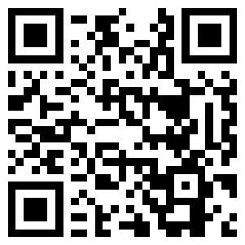

Communications
Most Association Communications will be sent through Facebook and Instagram accounts
Facebook
Instagram
STMAYOUTHBASEBALL
**Tournament photos can be sent directly through Facebook Messenger**

Slide 20

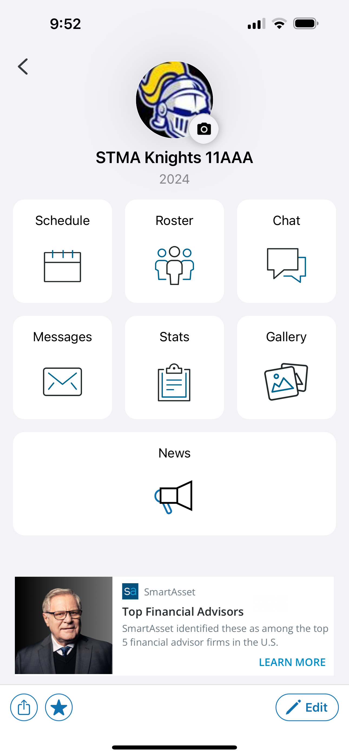
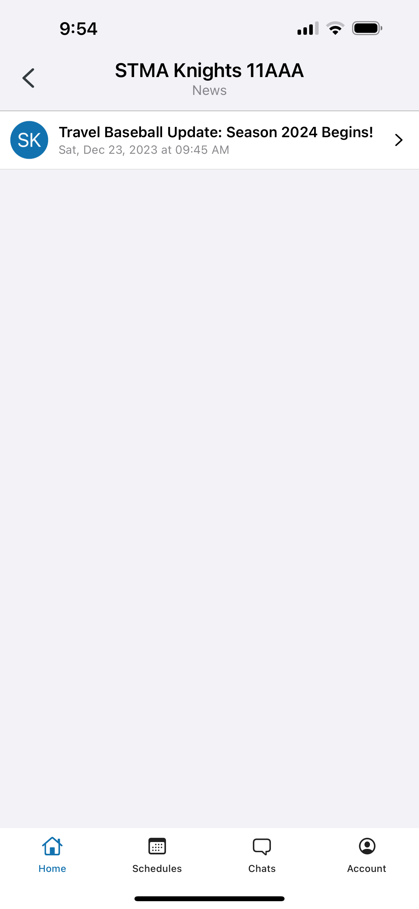

Communications
Travel League and Team Specific Communications through SportsEngine
SportsEngine Help For Parents: SE Help For Parents
Mobile App Setup and Guide: mobile start up guide
Team Chats
Photo Gallery
Calendar
Roster w/parent contact info

Slide 21
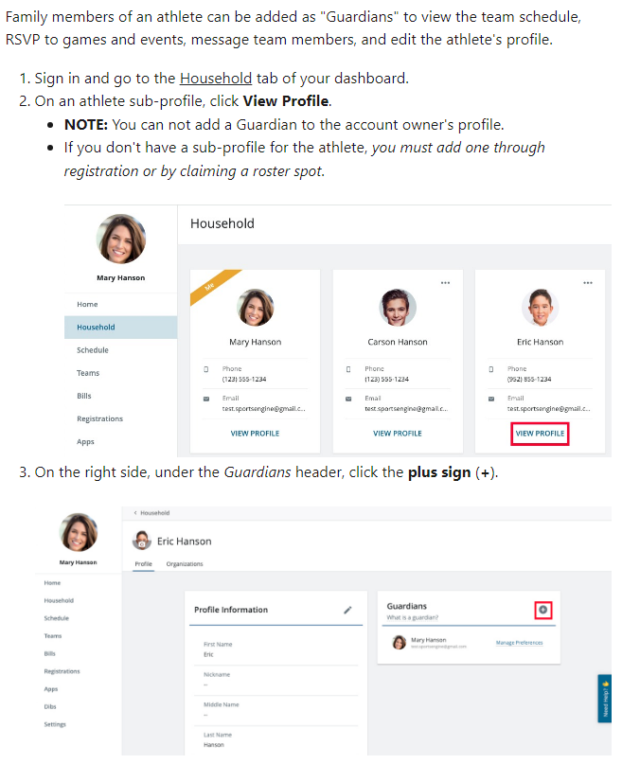
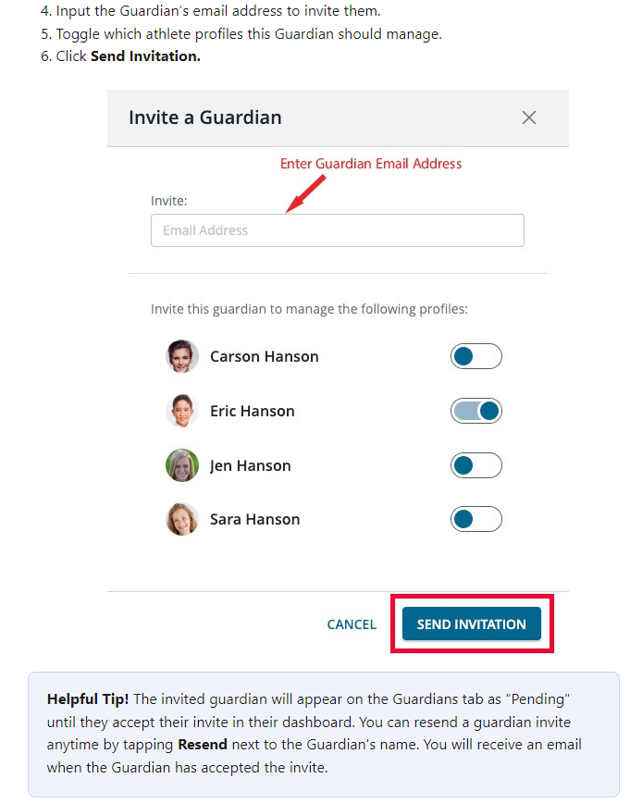
Communications - Guardians
SportsEngine Help For Parents: SE Help For Parents
Add a Guardian: How to Add a Guardian

Slide 22
Youth Baseball for High School Players
Options for both High School Players and Non-High School players
High School Players are placed on Legion or 15AAA teams
Non-High School Players are placed on 16u or 19u teams
Available to players 15 – 19 years old
Registration for High School Players will start in February and end by April 1st

Slide 23
THANK YOU
To all players for making the choosing to participate in STMA Traveling Baseball.
Have fun, give your maximum effort, and be a great teammate.
To all parents for making the commitment of time and money to allow your child to participate in STMA Traveling Baseball.
Enjoy watching the players play, let the coaches coach and be a great fan.
Together we are responsible for maintaining the STMA legacy of good sportsmanship and competitive baseball.
GO KNIGHTS!

Slide 24
Meet Your Coach/Team
Visit your coach at the table outside to provide Volunteer check, gather any team specific information
Coaches – When complete return to auditorium to return checks and provide contact details for all coaches

