Slide 1





Seacoast United/Exeter Hawks
Home Workout Plan -
March 23rd - 27th

Slide 2
Seacoast United Home Workout Plan
The Seacoast United Home Workout will consist of a 5-Day Plan to keep our players active in this time away from Team Training Sessions. The activities we have are all designed so players can perform on their own in a limited space, so should be accessible for all our players.
The Seacoast United Home Workout Weekly Plan will consist of the following:
Aerobic Workout
Technical Based Workout
Core Workout
Upper Body Workout
Lower Body Workout
Soccer Homework
This presentation will include a weekly schedule, plus descriptions of the activities we would like the players to perform in each of the workouts

Slide 3
Weekly Schedule (3/23-3/27)
Monday 23rd March | Tuesday 24th March | Wednesday 25th March | Thursday 26th March | Friday 27th March
Dynamic Warm Up | Dynamic Warm Up | Rest | Dynamic Warm Up | Dynamic Warm Up
Technical Workout | Technical Workout | Soccer Homework | Technical Workout | Technical Workout
Aerobic Workout (without the ball) | Core Workout |  | Aerobic Workout (with the ball) | Core Workout
Cool Down | Upper Body Workout |  | Cool Down | Lower Body Workout
 | Cool Down |  |  | Cool Down

Slide 4
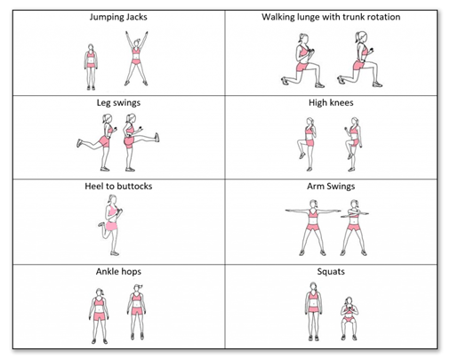
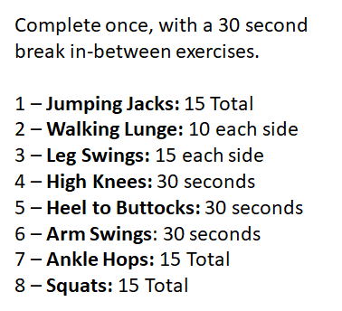
Dynamic Warm Up
~ Mon, Tues, Thurs and Fri ~

Slide 5
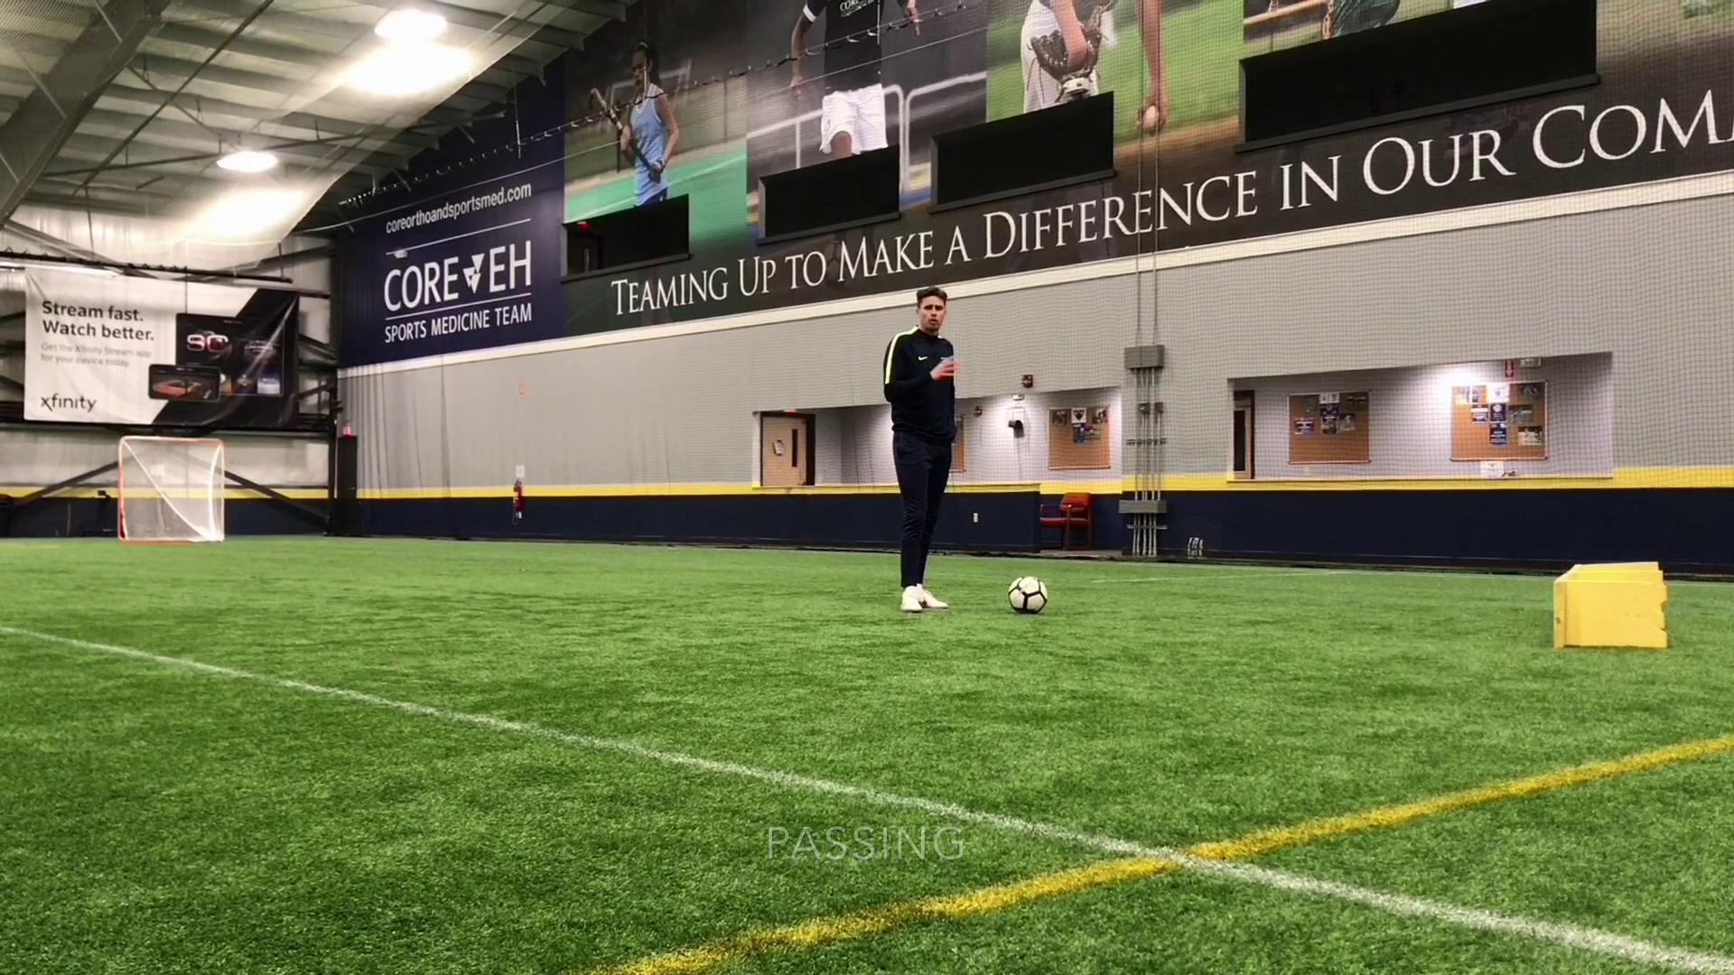
Technical Workout
~Monday, Tuesday, Thursday, Friday~

Slide 6
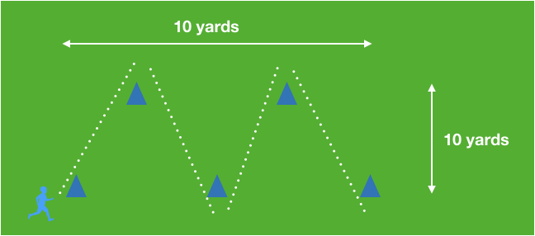
Aerobic Workout
~ Monday (without the ball) & Thursday (with the ball) ~

Slide 7

Aerobic Workout
~ Monday (without the ball) & Thursday (with the ball) ~

Slide 8
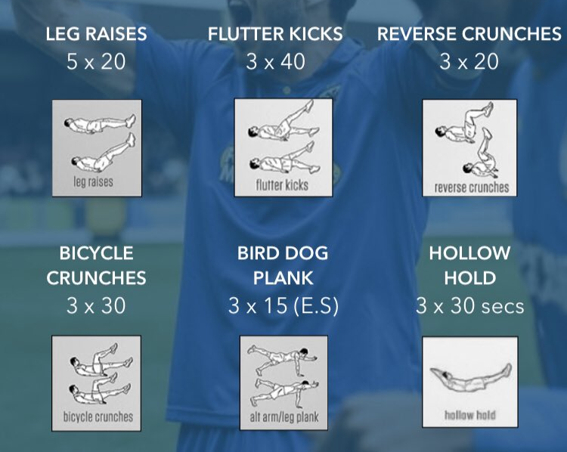
Core Workout
~Tuesday & Thursday~
***Players should complete 1 set of all 6 activities, before taking a 1 minute rest. Repeat this process until all sets & repetitions are complete for all exercises***

Slide 9
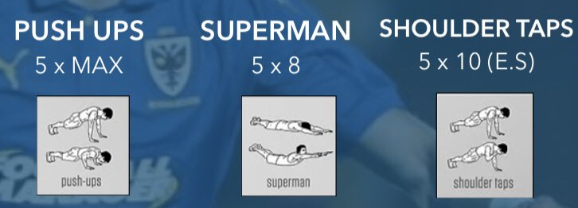
Upper Body Workout
~Tuesday~
***Players should complete 1 set of all 3 activities, before taking a 1 minute rest. Repeat this process until all sets & repetitions are complete for all exercises***

Slide 10
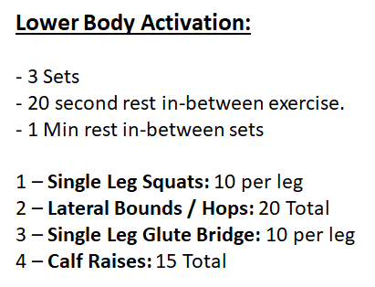
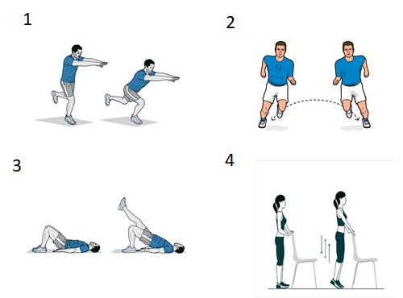
Lower Body Workout
~Thursday~

Slide 11
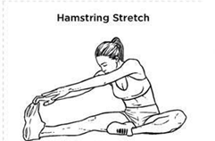
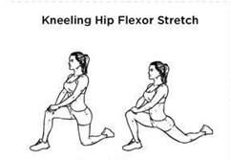
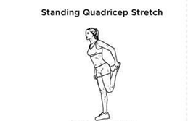
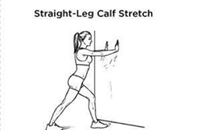
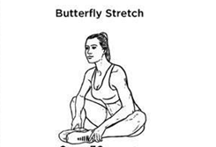
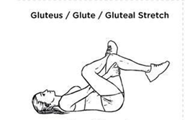

Cool Down
~ Mon, Tues, Thurs and Fri ~

Slide 12
Homework
~Wednesday~
We want to build your knowledge of the game, and get players thinking a bit.
Let us know who your favorite player is in your preferred position, and what key qualities that have that separate them from the rest. This should include both in and out of possession.
This can include: - Key skills. - What do they do well when they have the ball at their feet? - How about when their team mate has the ball? - What are they doing well when they are trying to receive the ball? - What about when the opposition have possession?
Please email your Head Coach by Friday with your answers via email.

Slide 13

Stay Safe & Stay Fit

