Slide 1
Delano Pitching Plan and Philosophy 2025

Slide 2
Attitude and Philosophy
“Be great at what you’re good at.”
  Know your strengths as a pitcher and use them often.
Control the game
  You hold the ball- the game should move at your pace (faster or slower).
  Have great body language- non negotiable.
Perfection on the 10%.
  90% of our job is pitching the ball- the other 10% will win or lose close games.
  10%- Fielding your position, bunt coverage, holding runners, backing up bases, pickoff plays from catcher, etc.
Win the Firsts
  First pitch of the at bat
  First batter of the inning
  First inning of the game
Develop a pre pitch routine
  Get sign, deep breath, execute
Middle Wins!
  Pitchers miss fastball spot by average of 8-10 inches. Middle target early in the count and move out of the zone late.
Smell blood in the water
  Hitters average .158 in 0-2 counts. Don’t mess around, best time to attack.

Slide 3
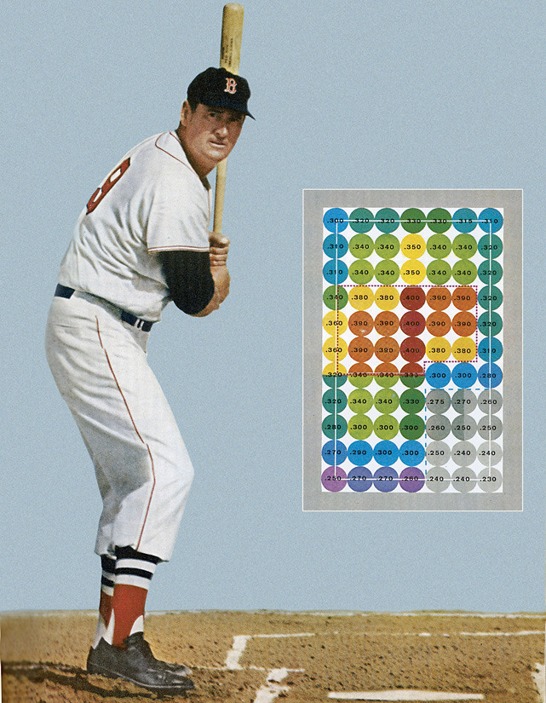

Slide 4
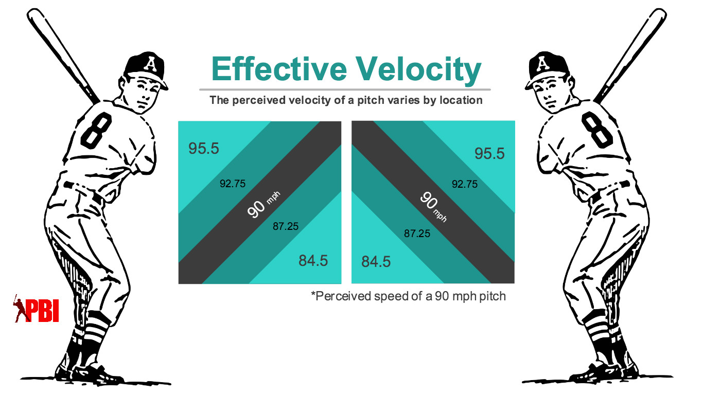

Slide 5
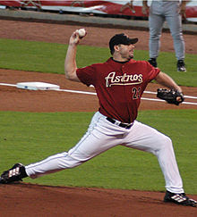
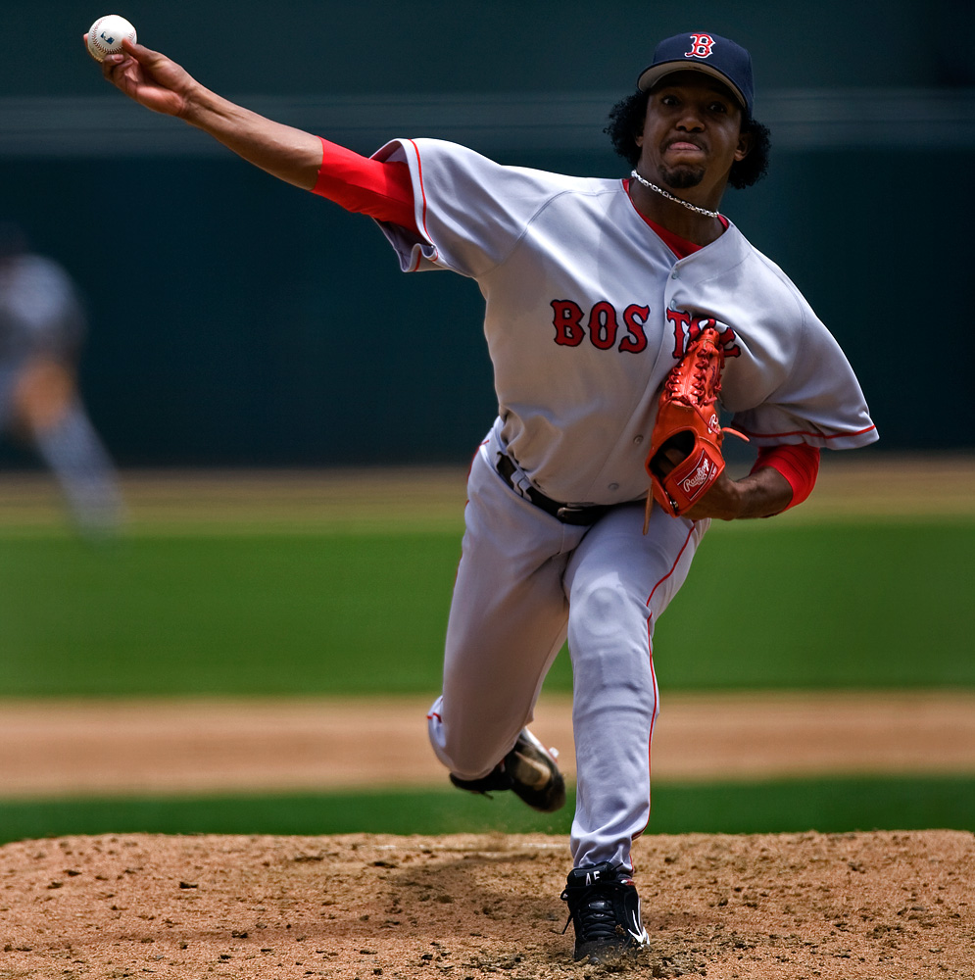
Mechanics for Consistent Performance
Athletic Lower half
  Have to engage the rear leg early in the delivery
Arm must be ON TIME
  Cocking position (L-position) at foot strike
Keep front side closed as long as possible
  Direction must be in line with the target at footstrike
Firm glove side that centers up over lead leg at release
  Don’t pull glove side in, think “bite the apple”
Head posture
  Eyes must be level at release
  Head is the biggest culprit of poor balance and inconsistent release point

Slide 6
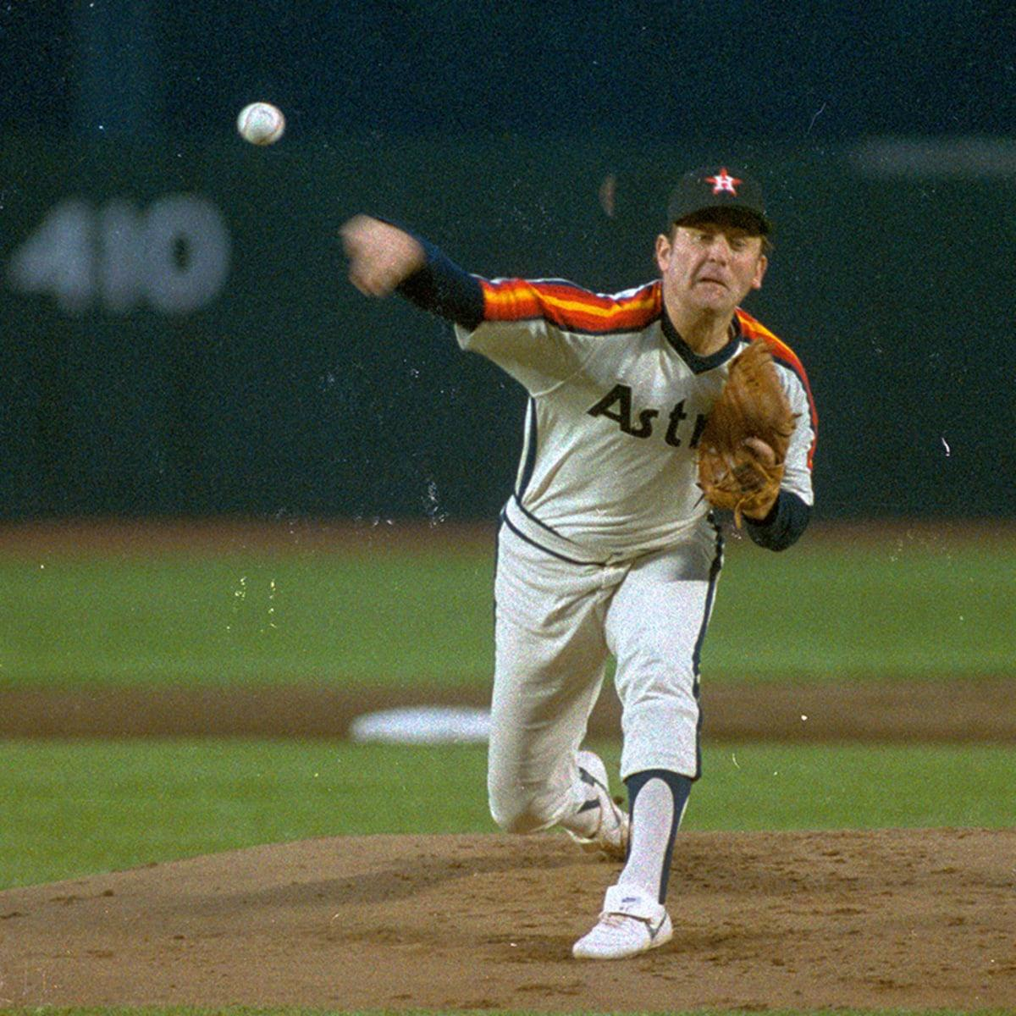

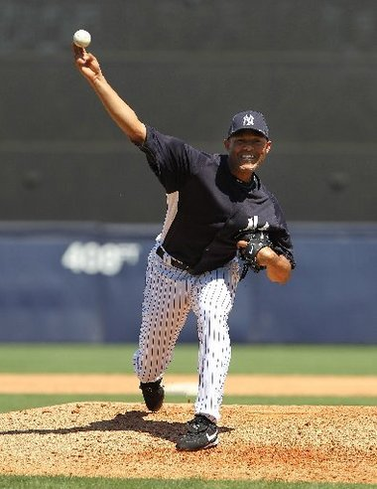
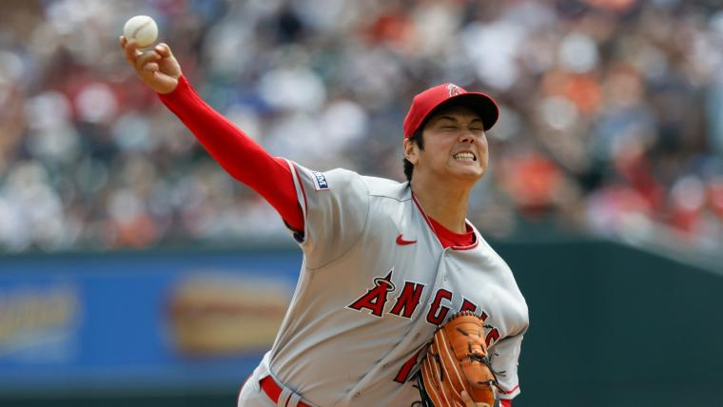
Good!

Slide 7
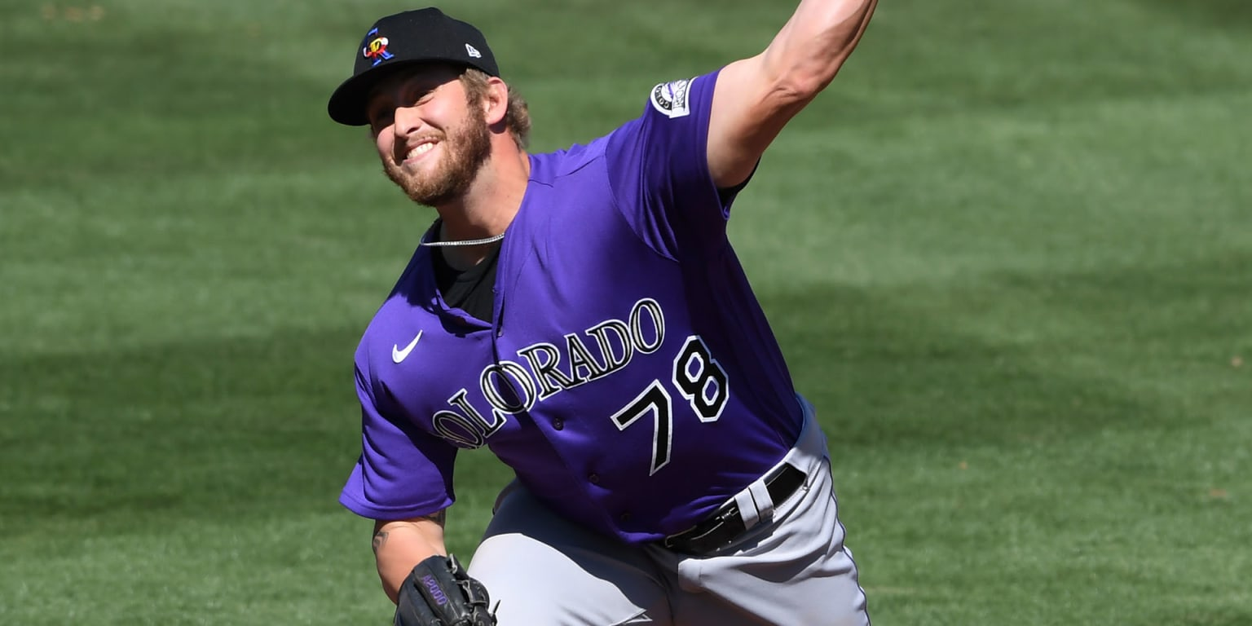
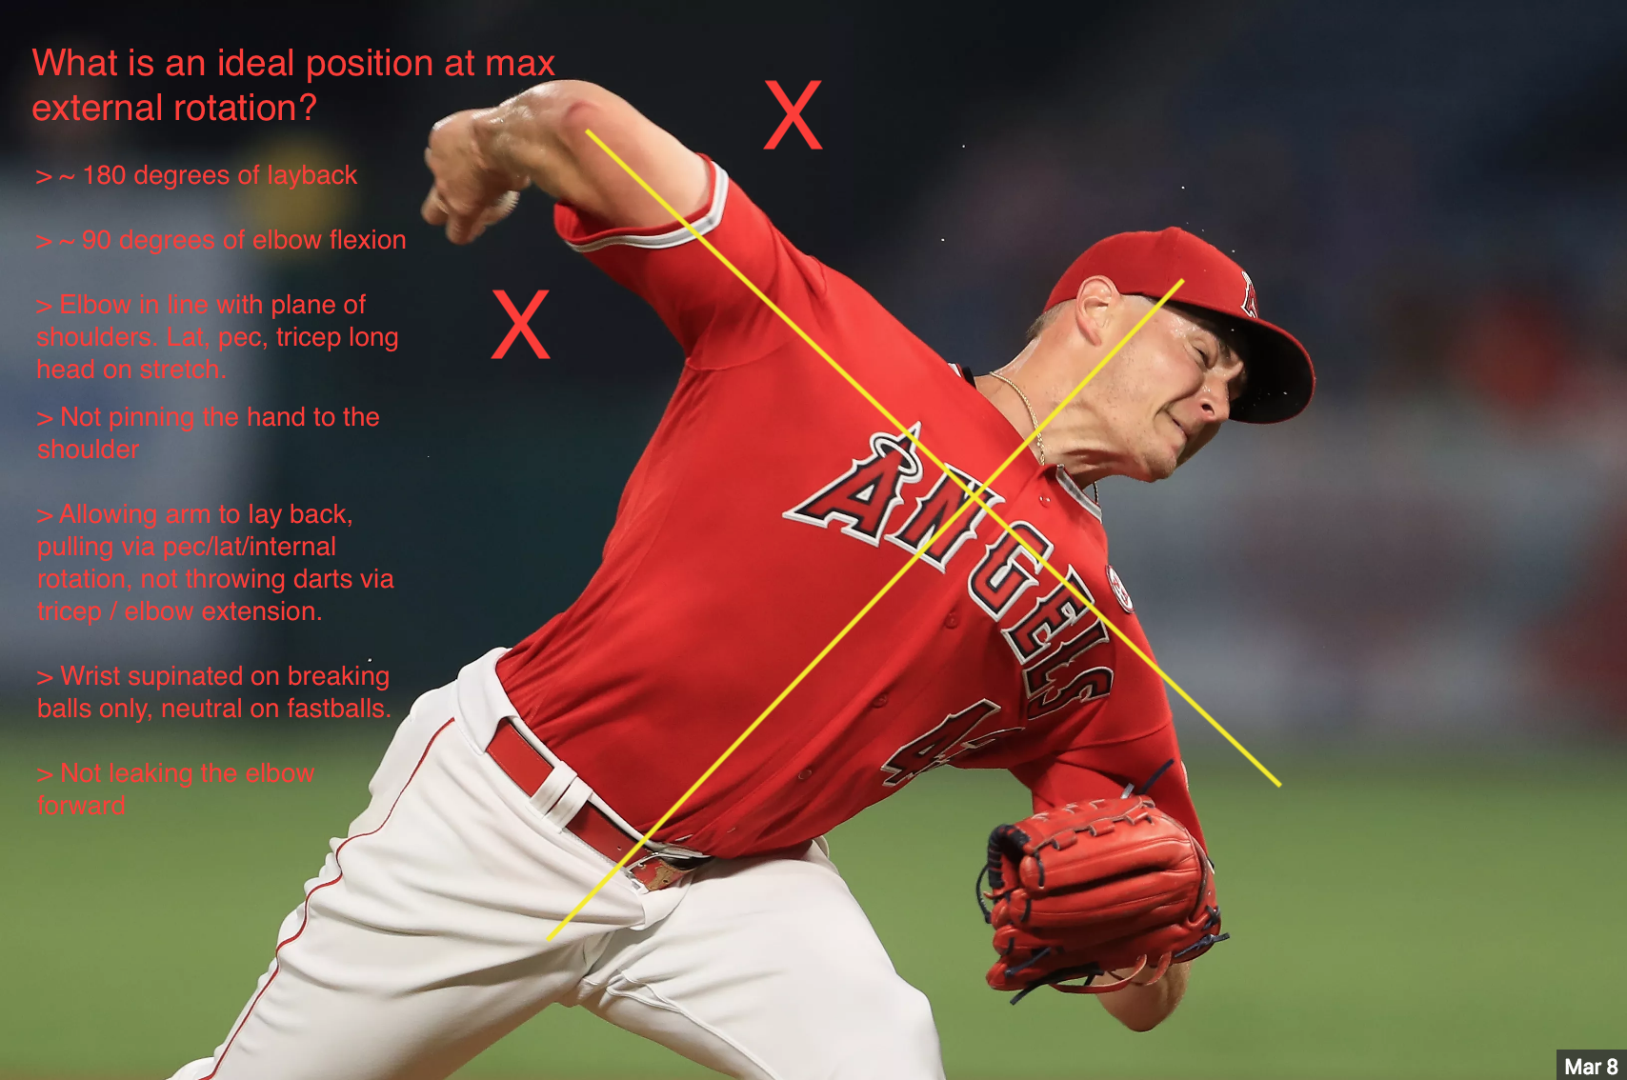
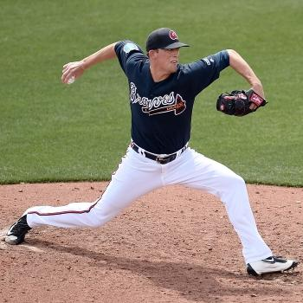

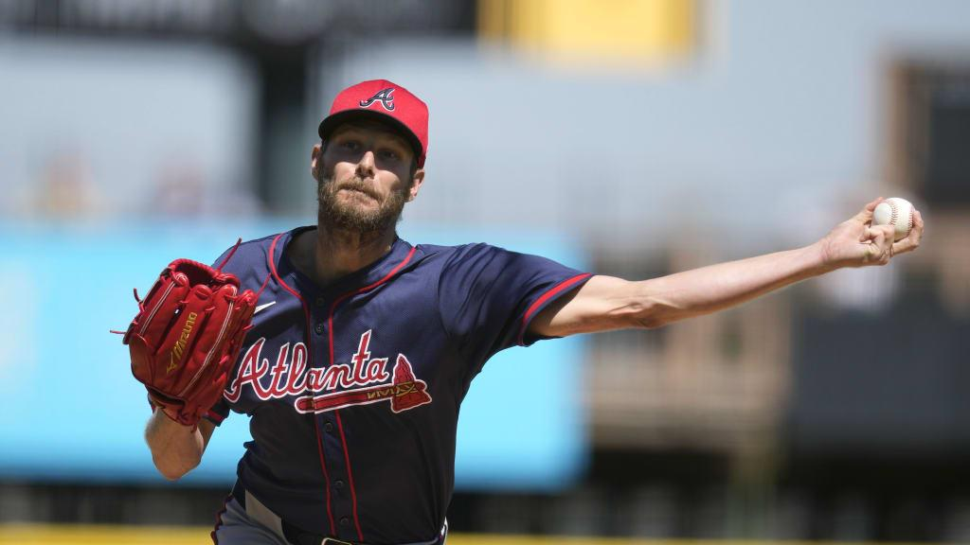
BAD
Left is Sale bad year with BOS, Right is Cy Young with ATL. Check glove side difference

Slide 8
Pre Throwing
Warm up to throw, don’t throw to warm up
  Should be sweating a little bit before picking up a baseball
Pre throwing is a great time to drill mechanics as well
  Med Balls for training rotation and lower half
  Plyo balls for training arm action
  Mobility stretches to work on separation
Do not “go through the motions” during your warmup. Have a plan and a purpose and execute.

Slide 9
Catch Play/Practice
Have a plan and a purpose every day
  Don’t just play catch with your best buddy, find someone who wants and needs the same things you do
Catch play is our “batting practice”
  It’s our time to try things, experiment, work on mechanics, etc.
  Don’t go through the motions
Throw all your pitches every day
  Changeups from 75 ft or 90 ft every single day is the best way to learn
Be an athlete!
  Don’t be stationary in your catch play, move your feet.
Practice 2x as much out of the stretch as the windup.
  The most important pitches of the game will come out of the stretch.

Slide 10
Post Throwing
Treat throwing recovery the same way as a workout recovery
  Light movement that brings blood flow to the arm and activates recovery process
  Get mobility back in the torso and hips
  Listen to your body- on high volume/high intensity days, we don’t need to add more stress. Recovery days we can do more.
Understand and embrace soreness
  Being sore is ok, it is how we develop strength and endurance in the arm
Take nutrition and sleep seriously
  Aim for a gallon of water
  Eat the same amount of protein as body weight (175 lbs= 175 grams of protein)

Slide 11
Goals/Metrics
Goal: 60%
  First pitch strikes
  Overall Strike Percentage
  2 of 3 (2 of the first 3 pitches to a batter are strikes)
  Breaking ball Strike percentage
Goal: 3/1 K/BB ratio
Goal: Less than 50 SB’s given up all year
  RHP must be 1.3 or less to home
  Must have different timing holds to stall runners
Team ERA: Under 2.50

